Slide 1
Tutorial Arduino IDE
For the ESP 8266

Slide 2
Setup
Download the latest Version from https://www.arduino.cc/en/Main/Software
Install IDE
Press „Datei“ -> „Voreinstellungen“ and add http://arduino.esp8266.com/stable/package_esp8266com_index.json under „zusätzliche Boardverwalter-URLs“

Slide 3
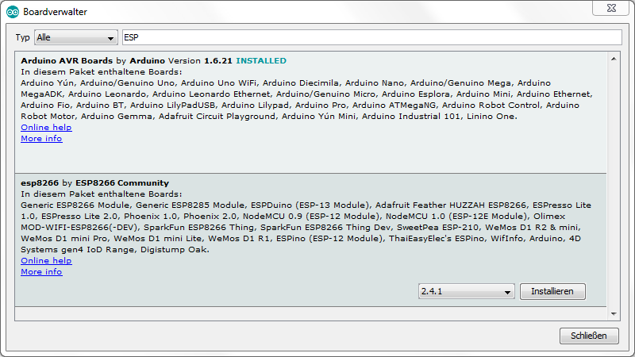
Setup
Now you can download the ESP board support by clicking on „Werkzeuge“ -> „Board“ -> „Boardverwalter“ and type in „ESP“

Slide 4
Setup
Now create your code or copy from

